Slide 1
OPEN A RESTAURANT IN A CLEVELAND NEIGHBORHOOD
Mingdong Fan
12/30/2018

Slide 2
Outline
Introduction
Data
Methodology
Results
Analysis
Discussion and Conclusion

Slide 3
Introduction
Problem to solve: To find out what business has low supply and high demand at which location.
Project: Use the city of Cleveland as an example to demonstrate how data science can help people who are looking to open a common business like a pizza place or a sandwich place find the ideal location.

Slide 4
Data
Geographical Data: A geojson file that features the name and the GPS coordinates of 36 Cleveland neighborhoods.
Venue Data from Foursquare: Venues within 1km of the neighborhood center (coordinates from above). Top 10 venues for each neighborhood are listed and then converted to dummy variables for the convenience of clustering.

Slide 5
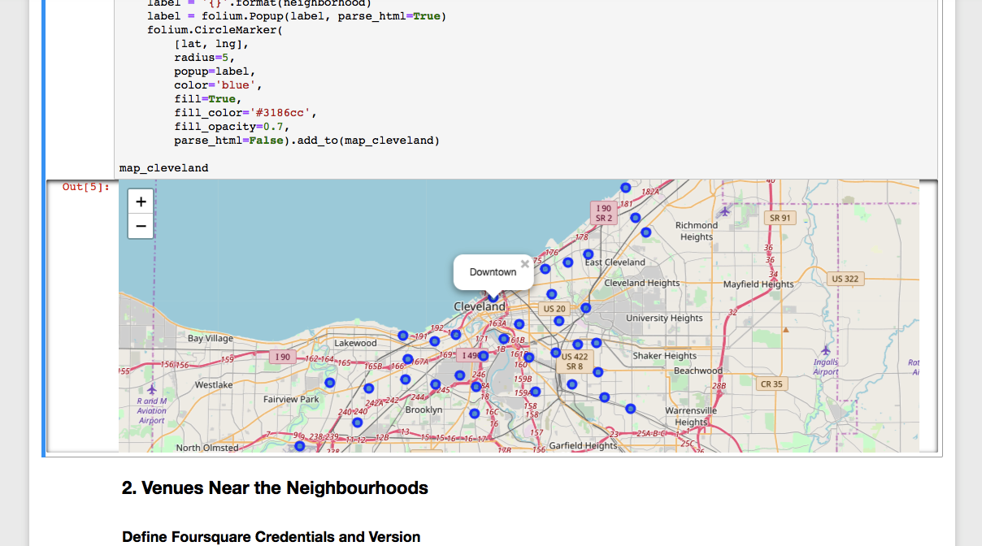
Geographical Data

Slide 6
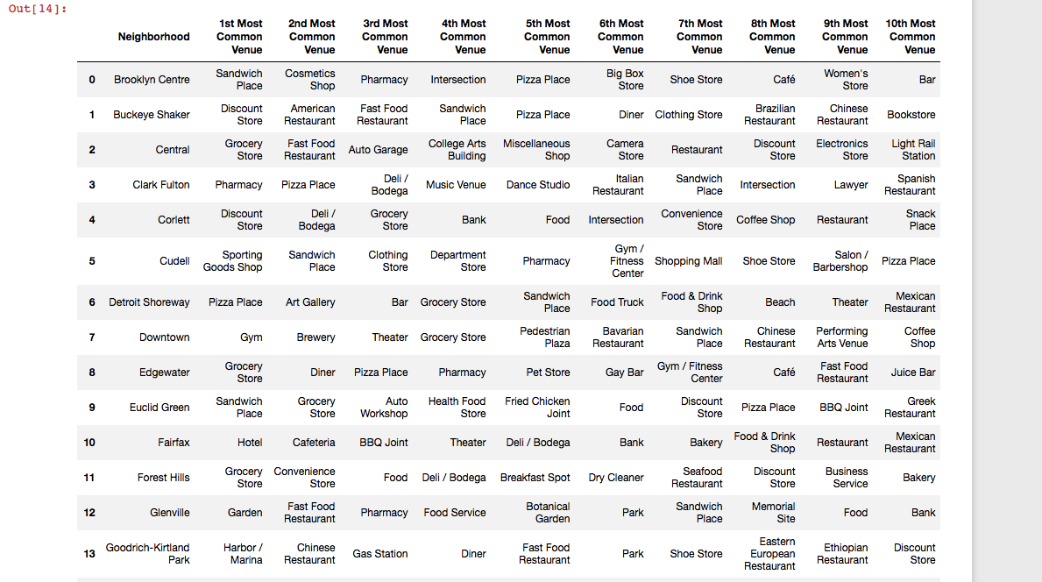
Venue Data from Foursquare

Slide 7
Methodology
Clustering: Based on venues, Cleveland neighborhoods are grouped into 3 clusters.
Reason for clustering:
If a cluster is big it suggests a widely used and successful business model in those neighborhoods.
Neighborhoods in the cluster not having some of the popular venues means that there might be low supplies and high demand for them.

Slide 8
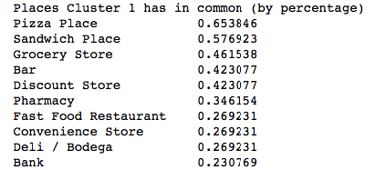
Results: Analysis of the Cluster
The 36 neighborhoods are grouped into 3 clusters. The biggest one has 29 neighborhoods.
The top 10 venues in this cluster include 5 food venues including the top 2 being pizza and sandwich with 65.4% and 57.7% of the neighborhoods having them in their top 10.

Slide 9
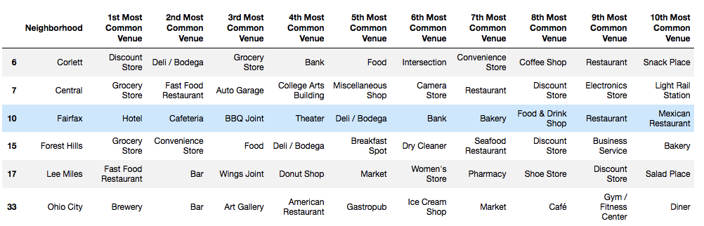
Analysis: Neighborhoods without Top 2 Popular Venues
Six neighborhoods have neither a pizza place and a sandwich place:

Slide 10
Analysis: Neighborhoods without Top 2 Popular Venues
5 of those 6 neighborhoods fill the vacancy of not having pizza or sandwich places by having at least 4 food-related venues.

Slide 11
Analysis: The Neighborhood without many food places
Low supply: Central, the only neighborhood that has only 2 food places in its top 10. It doesn’t have a pizza place or a sandwich place.
High Demand: It does have a college arts building and a light rail station in addition to other stores.

Slide 12
Discussion and Conclusion
Cluster with 29/36 Cleveland neighborhoods suggests a successful business model, especially for food industry where 5 food related venues made it to the top 10 most popular venues of the cluster. It means there is a high demand for food venues and they are well complemented by the other venues in those neighborhoods.

Slide 13
Discussion and Conclusion
There is a low supply and high demand for food related business in Central.
Low supply: Only 2 food places in its top 10. No a pizza place nor a sandwich place.
High Demand: Surrounded by a college arts building a light rail station and other stores.

Slide 14
Conclusion
Opening a pizza place or a sandwich place at Central might be a great idea.

Slide 15
Thank you

